Slide 1
Share and Act
WKSP 722 Module 4, Lesson 1
Notes:
Welcome everyone to our final module, which outlines some best practices for creating data visualizations to present to your stakeholder.

Slide 2
The Data Science Workflow
Ask questions
Prepare and Plan
Process
Analyze
Share and Act
Notes:
So this is our data science workflow. We’ve analyzed our data with our data models. Now we need to present what we learned.

Slide 3
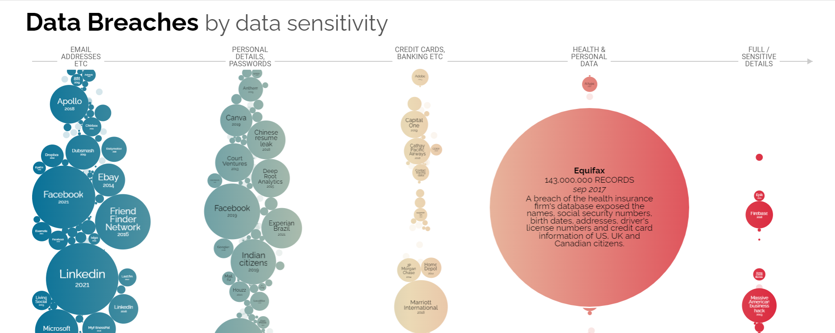
Data Visualization
The graphic representation and presentation of data
Notes:
First let’s talk about data visualization. Data Visualization is the graphic representation and presentation of data.
A good rule is that the audience should know exactly what they are looking at in the first 5 seconds. And 5 seconds after that the audience should be able to understand the conclusions your visualization is making.

Slide 4
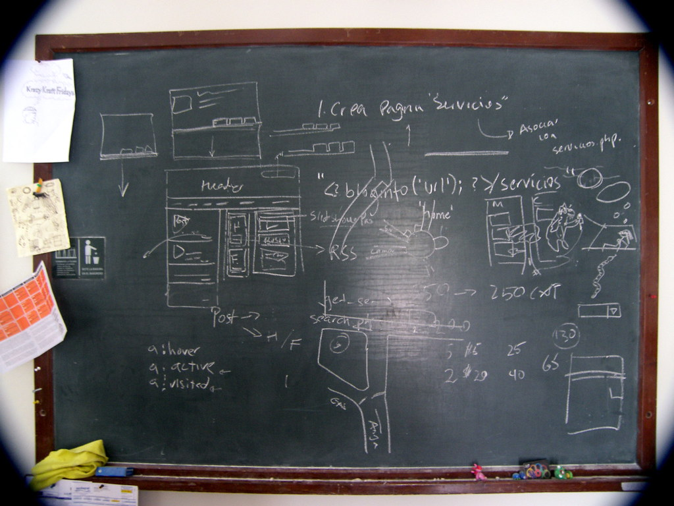

Visualizations
This Photo by Unknown author is licensed under CC BY-SA.
Notes:
At the end of your data science project, you probably have a pretty good size notebook of the different results you’ve found throughout the process.
When presenting to your stakeholder, you don’t need to show ALL of your work. Remind yourself how familiar they are with your methods and work, and present accordingly.

Slide 5

Before You Start
Structure and organize your thoughts
Notes:
First step is to organize your thoughts. Go through your work and see how all the pieces fit together.
Think about the objectives and the conclusions you’ve reached by sorting through the data.
Think about the patterns and things that surprised you.
The key findings in your data will help you set the stage for how you will present your work.

Slide 6
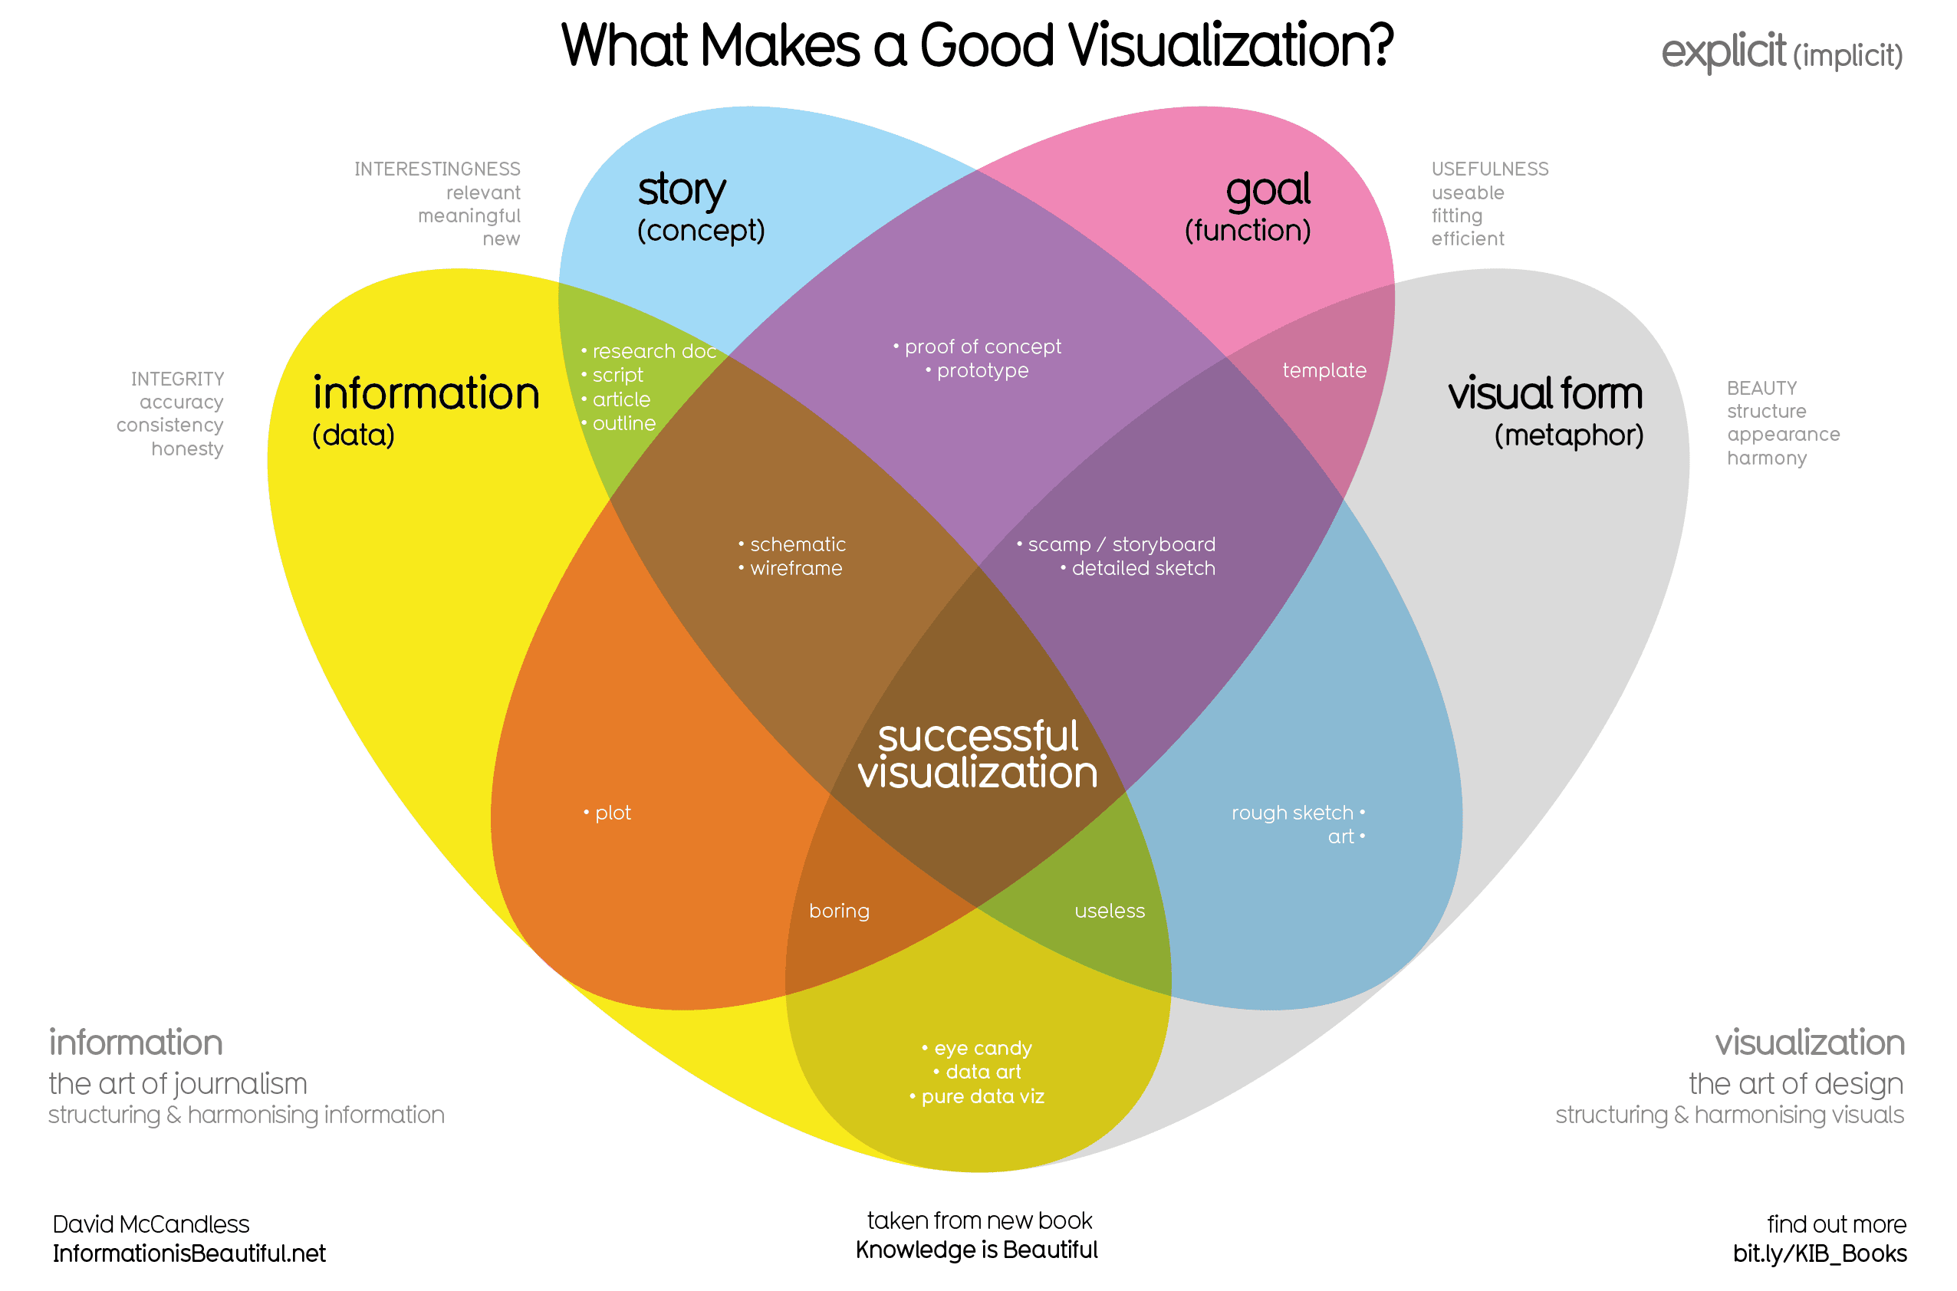
Notes:
There are lots of different schools of thought on what goes into making a good data visualization.
This visualization comes from David McCandless (https://www.informationisbeautiful.net/visualizations/what-makes-a-good-data-visualization/)
He explains that successful visualization is an intersection of a Story, Goal, Visual Form, and Information.
Story: a clear and compelling narrative or concept
Information: the data you are working with
Goal: a specific objective or function for the visual
Visual form: the beauty, appearance (an effective use of metaphor or visual expression)

Slide 7
Design Thinking
Empathize: emotions and needs of target audience
Define: audience needs (goal)
Ideate: visualization ideas
Prototype: For testing and feedback
Test: Show prototypes to people before presenting to stakeholders
Notes:
Once you’ve identified the major findings of your work, these are the steps you need to do to create a final visualization:
First you need to remember who your target audience is
Have they been involved with the work along the way, or is this the first time they are seeing it?
Do they have a background in the tools and methods that you used?
Next, define the goal of the visualization. This is usually the goal of the data science project.
What was the information gap the stakeholder was trying to fill? Try to focus your visualization towards answering that.
Ideate – In this step, try to form several kinds of ideas for presenting the data
Prototype – create several prototypes
Test - ask your fellow data scientists or domain SME for their feedback

Slide 8
Elements of Art
Line
Thickness, color, direction
Shape
Stick with 2D
Color
Space
Spacing between elements
Movement
Show change over time
Use sparingly
Notes:
Next let’s go over at a more granular level the different things you can do with your visualizations to make it easier for your story to be understood.

Slide 9
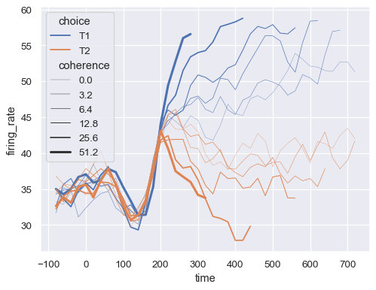
Elements of Art
Line
Thickness, color, direction
Shape
Stick with 2D
Color
Space
Spacing between elements
Movement
Show change over time
Use sparingly
Notes:
When using a line graph, you can thicken a line or use a particular color to bring attention to it, especially when comparing multiple lines.
In this graph, the bold T1 line is easiest to see.
If you want your audience to focus on just one line, such as the mean of different lines, color the rest one color, and make the main one a contrasting color and heavier weight.
Also, you can add a label explaining why that one line is standing out

Slide 10
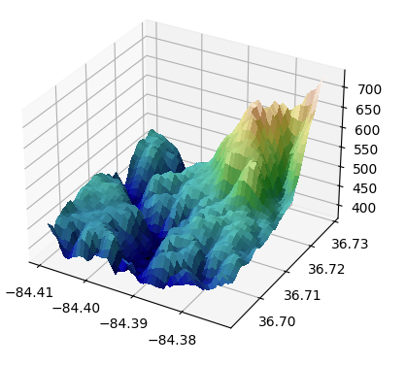
Elements of Art
Line
Thickness, color, direction
Shape
Stick with 2D
Color
Space
Spacing between elements
Movement
Show change over time
Use sparingly
Notes:
Shape – always stick with 2 dimensions
A 3D image will take the viewer much longer to understand the relation between the 3 different axes.
Better to represent multiple 2D images, than one 3D
Remember that your audience should be able to understand your visualization in the first 5-10 seconds without you having to explain it.

Slide 11
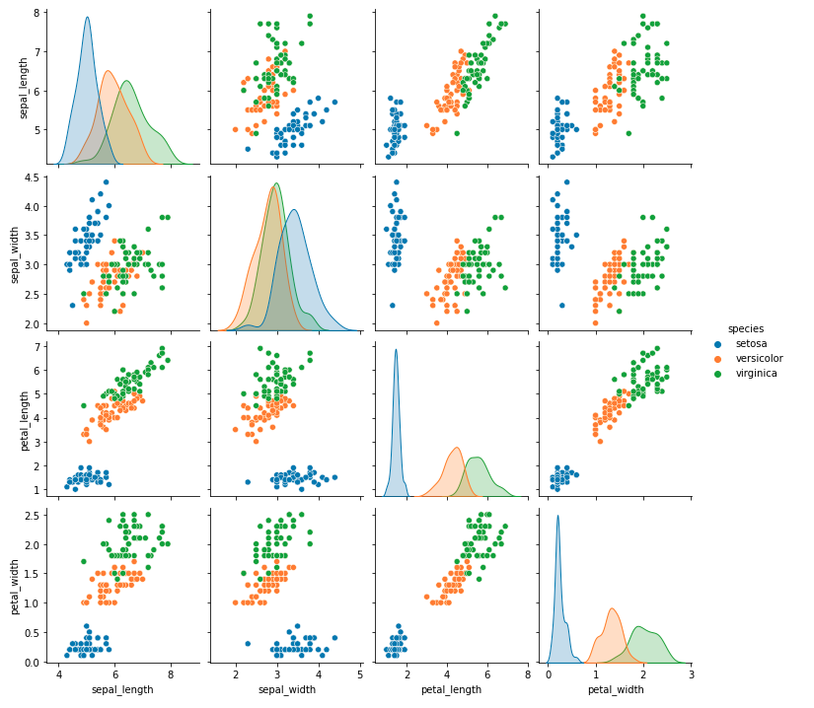
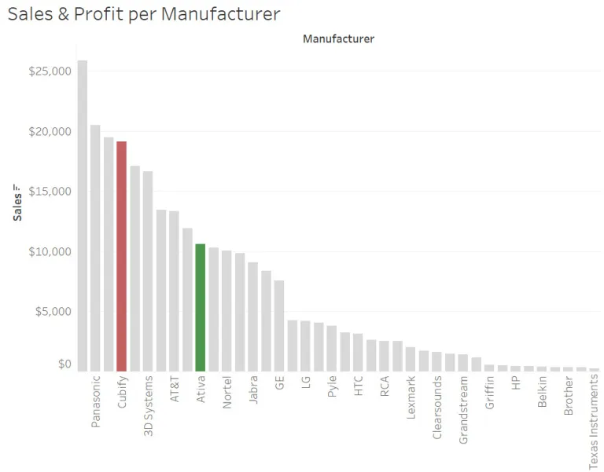
Elements of Art
Line
Thickness, color, direction
Shape
Stick with 2D
Color
Space
Spacing between elements
Movement
Show change over time
Use sparingly
Notes:
Color – Use to differentiate classes
Limit the variety of colors – they should not be distracting
Here, on the top we have a graph showing how the Iris dataset classes are separated using Seaborn’s pairplot
This works when there are just a few classes, 4 max.
On the bottom chart, we want to emphasize 2 of the bars in the bar chart.
So we color the rest a faded color, and make the 2 bold.
Also note, and this has to do with Shape, that the bar chart is sorted. That makes it much easier to read.

Slide 12
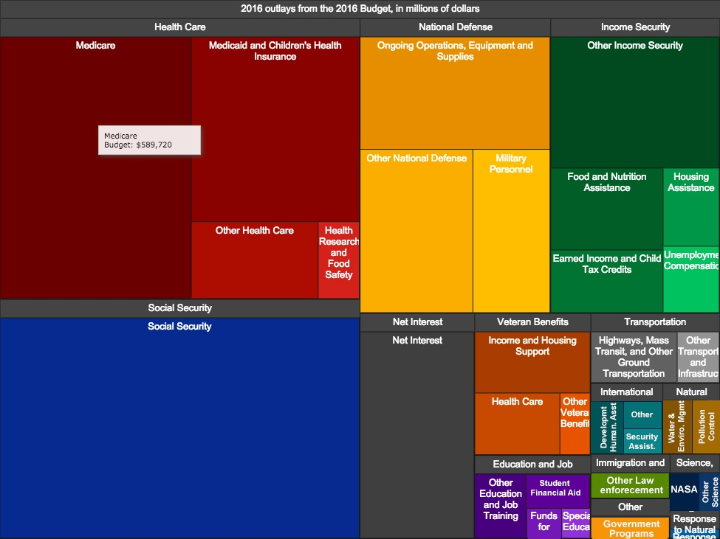
Elements of Art
Line
Thickness, color, direction
Shape
Stick with 2D
Color
Space
Spacing between elements
Movement
Show change over time
Use sparingly
Notes:
Space – try not to bunch elements up too closely
In this image, who is going to read the info in the bottom right?
The point of this visualization is to show the relative size of the largest pieces
Could instead use a bar chart, sorted for size, and labeling the largest pieces
Or a pie chart with the 3-4 largest pieces, and then “everything else”

Slide 13
Elements of Art
Line
Thickness, color, direction
Shape
Stick with 2D
Color
Space
Spacing between elements
Movement
Show change over time
Use sparingly
Notes:
Movement
Usually don’t use movement
But, if you’re trying to show change over time through an animation, that might work.
Example
https://vimeo.com/221683963
https://vimeo.com/221684350
Article: https://www.storybench.org/role-motion-visualizations/

Slide 14
Elements of Art
Line
Thickness, color, direction
Shape
Stick with 2D
Color
Space
Spacing between elements
Movement
Show change over time
Use sparingly
Notes:
This chart uses movement to show the progression of time. It shows a unidirectional trend of higher incomes over time, which is easy to understand.
Anything more complex, like if the motion was in multiple directions, I would not use animations for. It can be distracting, but if you do it right, it can also be memorable than a static figure.

Slide 15
Elements of Art
Line
Thickness, color, direction
Shape
Stick with 2D
Color
Space
Spacing between elements
Movement
Show change over time
Use sparingly

Slide 16
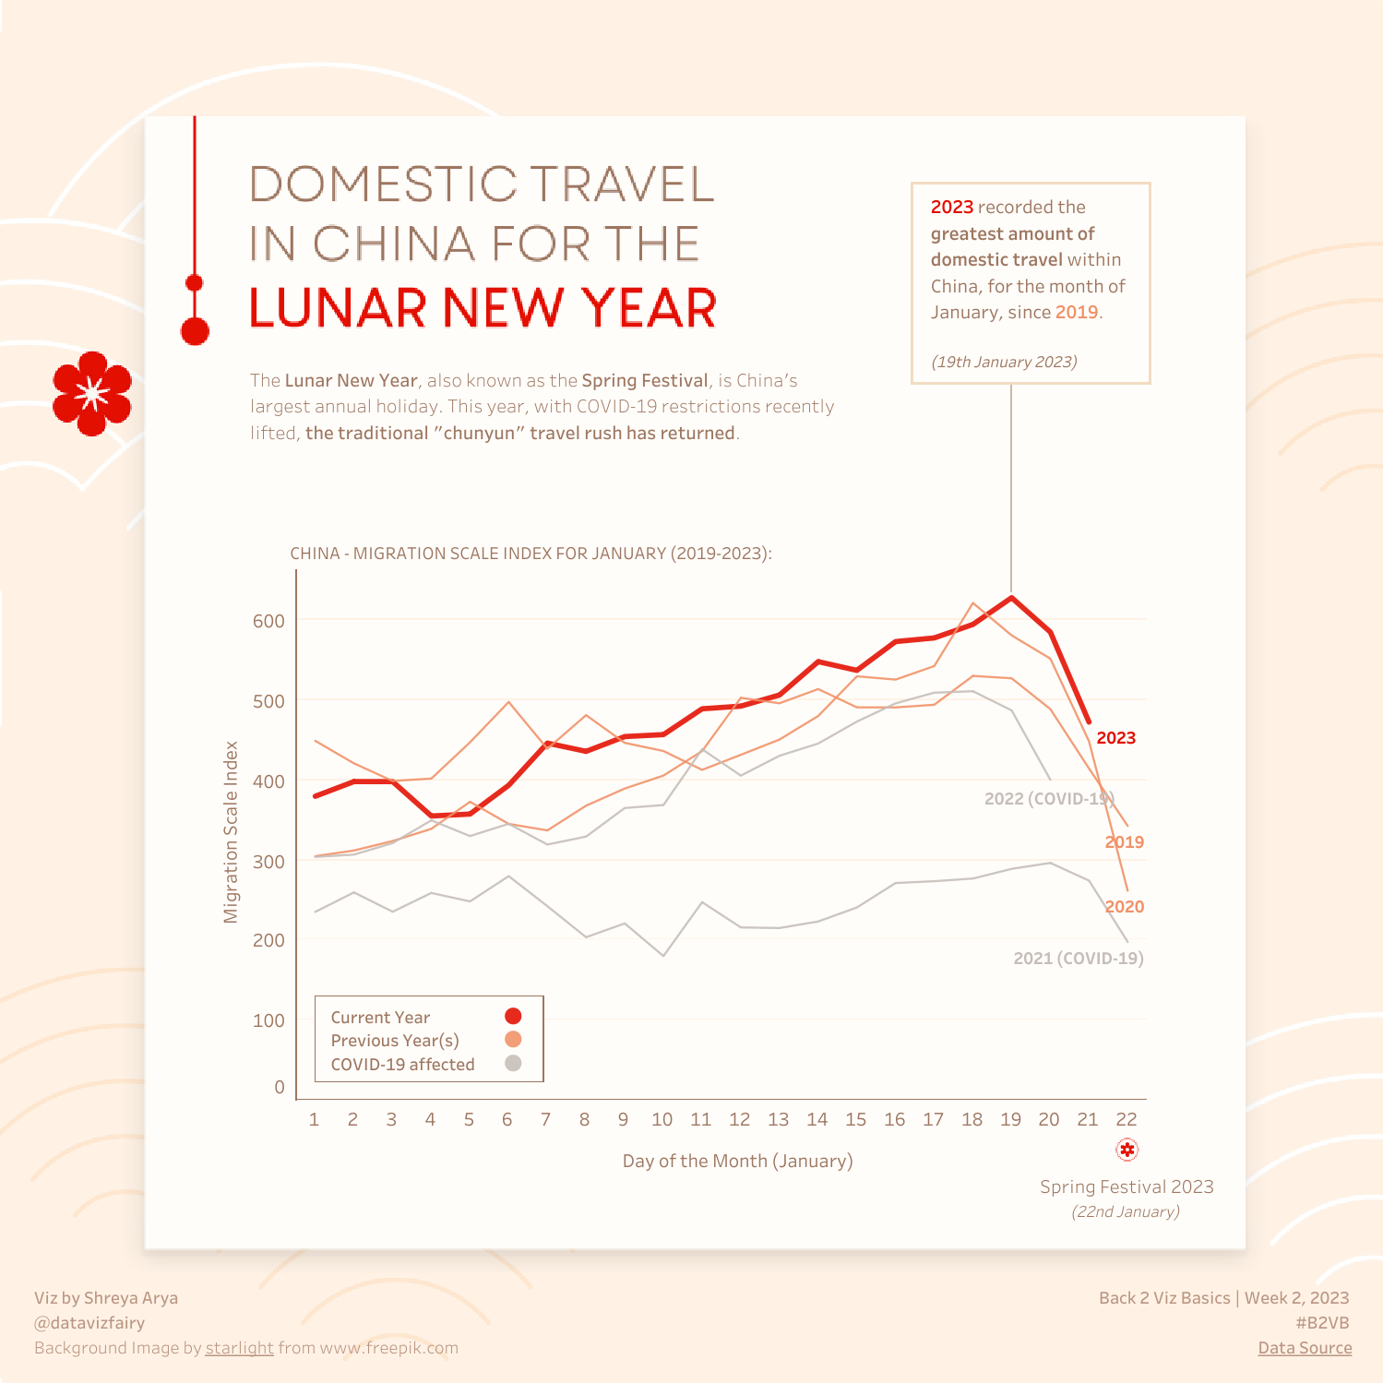
Outline main conclusion
Main line is Bold
Outliers you don’t want to give weight to are gray in color
Notes:
Let’s look at some good visualizations from the web. This one comes from the website Tableau Public. It shows Domestic Travel in China for the Lunar New Year
I like this visualization for several reasons:
The main conclusion is not only highlighted bold, but also there is a marker with text explaining the key finding
It immediately catches your eye as the first thing to focus on
The creator considers the COVID years to be outliers in spending, and so they have de-emphasized them with a dull gray color.

Slide 17
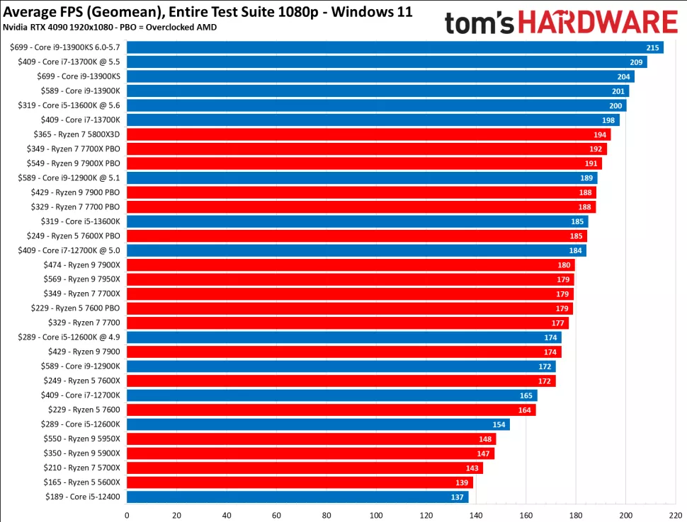
Sort bars – Makes it easier to find the most important or lest important results
Don’t use too many colors
Notes:
This is an example of a bar chart showing CPU performance from the website Tom’s Hardware.
I want to point out a few things:
First, the color scheme is limited to 2 colors, which makes it easy to identify Intel vs AMD processors
If there was a trend of one brand being clearly better than the others, I would see it in a grouping of colors, as I do at the top showing a cluster of blue lines
Also, note that the bars are sorted.
You should always short the bars in your results, unless you have a particular reason not to.
It makes it easy for the viewer to summarize the data they are seeing
One example of a reason you may not sort is if one of the axes represents time, and you want to preserve the timeline of events.

Slide 18
Chart Types
Notes:
Let’s go over some rules of thumb on when to use the most common types of charts

Slide 19
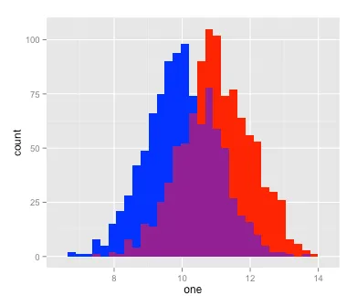
Single Variable
Notes:
If you’re trying to show information about a single variable, you can use a histogram. You should also test out different bin sizes that accurately tell the story of the data.
Sometimes you can use domain knowledge to determine bin size. For example, in the Titanic dataset, if we were try to use age to differentiate children from adults, we might consider what age during those times a child would be considered as coming of age. If that age is 15, then bin sizes of 5 might be sufficient to divide that data.

Slide 20
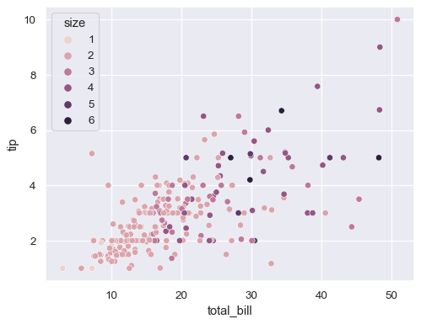
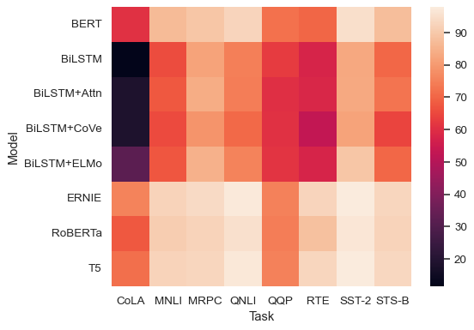
Relationship Between Variables
Notes:
If we want to show the relationship between two variables, you can use a couple of different methods:
We’ve used a scatter plot extensively in our exercises. You can add further information by coloring by class or group
Just make sure you don’t make it too complicated. The main thing you want to show is the relation trend line, or lack thereof.
You can also use a heatmap
You can use this to summarize relationship between all of the variables
So you get a broader view of the relationships in the dataset, but by summarizing, you don’t get the shape of each individual relationship
A good practice is to do a heatmap to see which variables are showing high overall correlation, and then do individual scatter plots of those to further explore the relationship

Slide 21
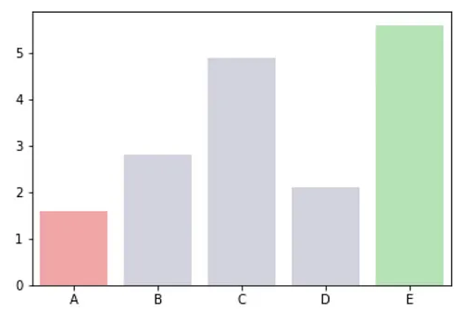
Measurement Change Over Time
Notes:
You can use bar charts for a number of reasons, one of which is to show measurement change over time. You can also use Stem plots.
I wouldn’t use line plots unless there is a unidirectional trend.
General rules of thumb as stated eariler{:
Minimize use of colors
Sort values unless you have a good reason not to – example you’re trying to show an event that happened with X-axis as time

Slide 22
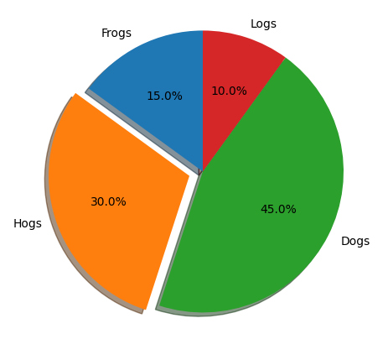
Proportion
Emphasize important piece
Preferably not too many pieces
Notes:
If you’re trying to show part of a whole, such as percentages, or budget, you can use a pie chart.
In this example, you attention quickly goes to the part that is pulled out, which should be the main point you’re trying to make
But:
Try not to have too many parts in the pie chart. If you have 6 or more, consider using another method to summarize the data.

Slide 23
Dashboards
Summarization
Interactivity
Real-Time Updates
Notes:
Let’s talk a little about dashboards. Dashboards are usually web-based tools that allow sharing of summarized information.
It’s real power comes from being interactive where the user can filter and limit the range of certain values and see how that effects other variables.
And also, these dashboards can update in real-time if you are able to provide a live data feed.
Before spending the time to build a dashboard, consult your project goal and your stakeholder if that is something they really want and need. I’ve seen many dashboards not used and they take a good amount of training and time to create.
Let’s take a look at some in action.

Slide 24
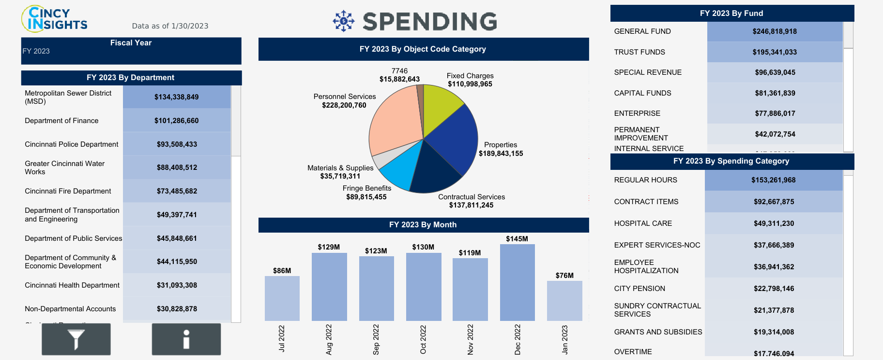
Notes:
https://public.tableau.com/app/profile/cincystat/viz/CitySpending/CitySpending
This is one highlighting the Cincinatti city budget. Let’s go into it and take a look
Things to point out:
Clicking on one part of the pie chart updates the data to show more specific information about that category
Not too complicated a view

Slide 25
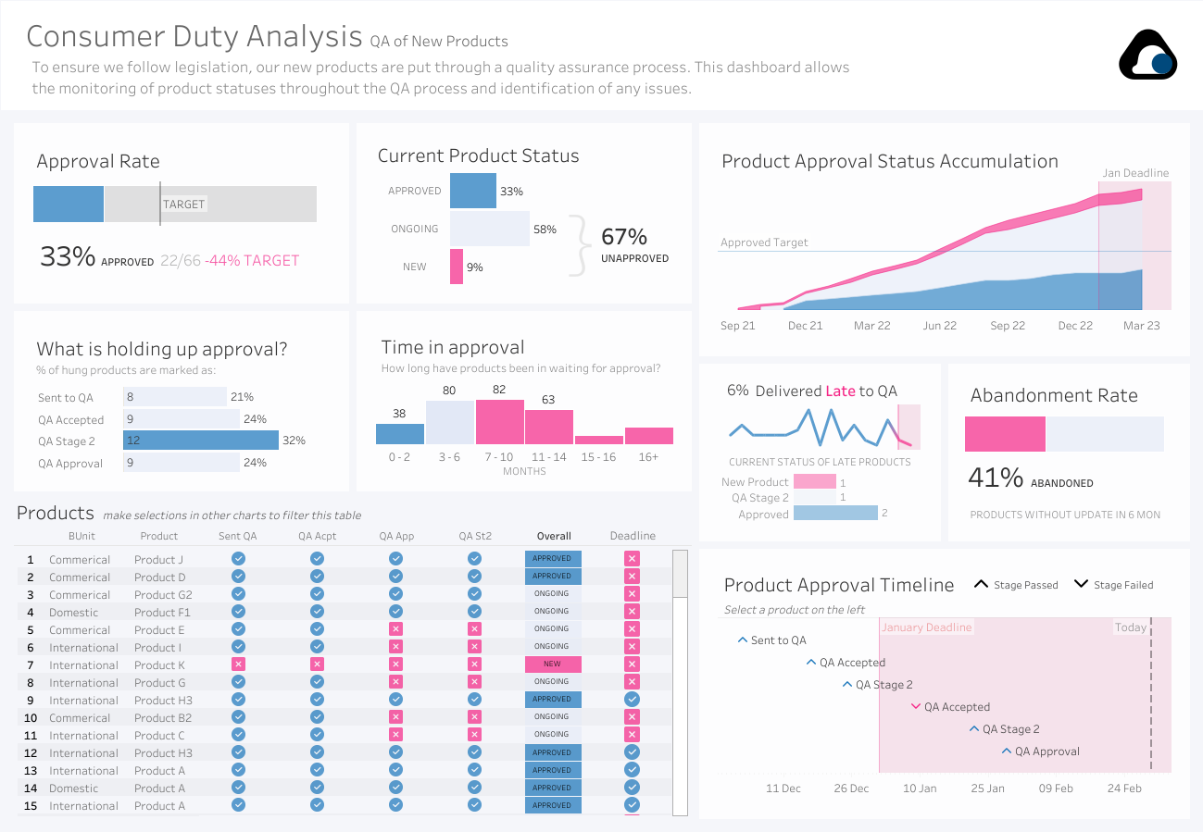
Notes:
https://public.tableau.com/app/profile/chris.meardon/viz/ConsumerDutyAnalysis-QualityAssurance/ProductApprovalStatus
This dashboard shows product approval status and information.
Things to point out:
Interactivity: clicking on “Time in approval” updates the “Product” tab to just show those that took a particular number of months
Many ways to refine, by clicking on various tabs such as “Current Product Status”
Also, hovering mouse over line charts shows their value. Allows smaller charts since you don’t need granular Y tick labels.

Slide 26
Notes:
The first area under the DOD’s ethical principals is “responsible”
Specifically, it states that “DoD personnel will exercise appropriate levels of judgment and care, while remaining responsible for the development, deployment, and use of AI capabilities.”
There is a difference between making the conclusion from your research clear, and leading the audience toward a path of your choosing.
You need to make sure you reflect and check to make sure you did not unintentionally insert any bias from your results because you believe it would tell a better story
Sometimes the conclusion of a data science project is that “we didn’t find anything statistically significant”.
It may mean you need to find more data, or change your goal.
But reporting things fairly is way better than selling a false story and having a stakeholder make decisions on false outcomes.

Slide 27
The Data Science Workflow
Ask questions
Prepare and Plan
Process
Analyze
Share and Act
Notes:
So this concludes this course on the Fundamentals of Data Science.
I hope you learned not just how to program in Python, but reference sources you can go to further develop your skills.
More importantly, I hope you learned why and when to use the variety of different tools that are out there.
And most importantly, I hope you learned a strategy for how to start, execute, and finalize a data science project in a way that will help DOD decision makers achieve real and useful outcomes.
I’m your instructor Lt Col Hiren Patel and as always, thanks for your time.

Slide 28


Notes:
Digital strategist Dona Wong says that effective visuals have:
Clear meaning
Sophisticated use of contrast
Separate the most important data from the rest
Refined Execution
Attention to detail to elements of art

Slide 29
Principals of Design
Balance | Emphasis | Movement
Pattern | Repetition | Proportion
Rhythm | Variety | Unity
Notes:
Balance: when the key visual elements, like color and shape, are distributed evenly.
Emphasis: visualization should have a focal point
Movement: which direction do you want the viewer’s eyes to follow when viewing the chart (left-right, top-down, etc)
Pattern: Use similar shapes and colors to create patterns in your data
Repetition: Repeating shapes, colors, chart types to make it easier for audience to understand
Proportion: change to emphasize the main message or data point
Rhythm: related to movement, sense of movement or flow in your visualization
Variety: some variety in chart type, color, size, shapes, values okay. Too much will lead to confusion
Unity: visualization should be cohesive, well organized

